Slide 1
State and Local Public Service
Don Kettl

Slide 2
”What Gen Z wants is to do meaningful work with a sense of autonomy and flexibility and work-life balance and work with people who work collaboratively”
Julie Lee, director of technology and mental health at Harvard Alumni for Mental Health

Slide 3
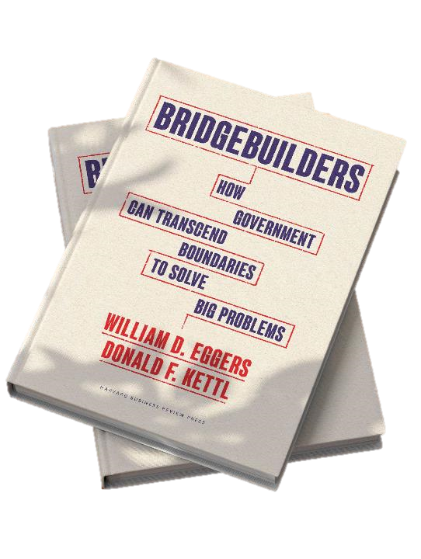
Bridgebuilders
How government can transcend boundaries to solve big problems

Slide 4
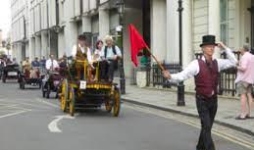
Forget self-driving car anxiety, in the 19th century driving without the help of a second person was a real concern…
Notes:
Across the pond, in the latter part of the 19th century, the UK Parliament launched a series of Red Flag acts regulating the use of mechanically propelled vehicles on roadways.
The goal? To protect pedestrians. All well and good. But the requirements were rooted in a previous mental model. Vehicles had to manned by a crew of at least three, with one person walking at least 60 yards ahead of the vehicle, carrying a big red flag to warn pedestrians and other vehicles—including horse-drawn carriages—of the approaching auto.
The act was eventually repealed in 1896, but by that time it had done its damage: Stifled the development of road transport and advances in automobile development by decades.

Slide 5
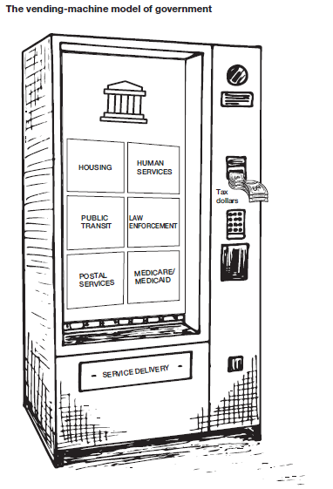
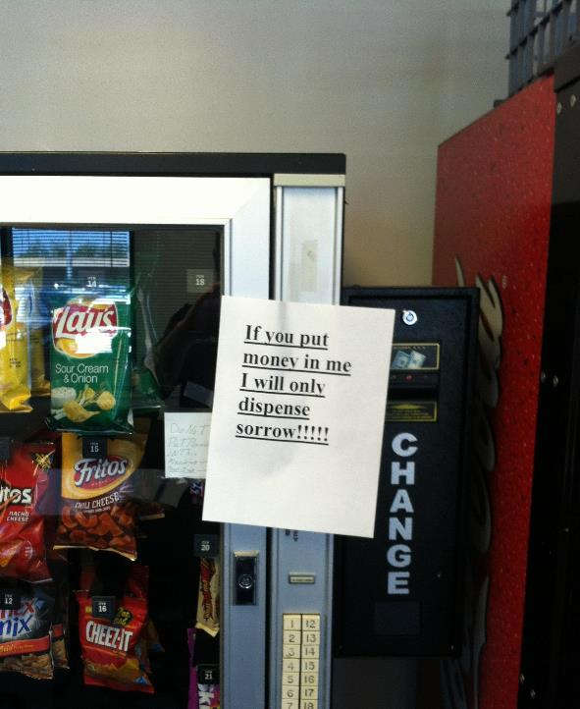
The “vending-machine” approach: Based on an outdated mental model
Money goes in but,
too often,
results don’t come out
Notes:
So why am I telling you these stories? Getting a smile is certainly welcome, but more importantly…to illustrate how people have a natural tendency to fit new information and innovation into their existing mental models.
In the case of our book topic, for decades we’ve largely had a mental model of govt as kind of a vending machine. You have a problem, you build an organization to deal with it, you put money in the slot, and you expect it to yield results. This model once actually worked fairly well.
Not so much today. It doesn’t at all reflect how most govt actually operates today, which is often horizontally, through complex public-private networks. Effective public management requires expertly integrating and managing these networks.

Slide 6
No problem that matters can be solved anymore by a single organization

Slide 7
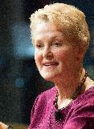
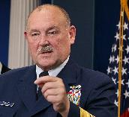
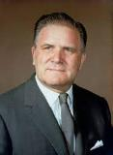
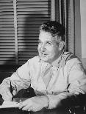
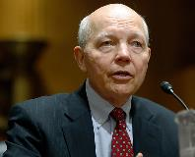
Swanee Hunt
Thad Allen
James E. Webb
Clara Barton
Michael Day
Leslie Groves
Amina J. Mohammed
Charlie Bolden
Audrey Tang
John Koskinen
BRIDGEBUILDERS
See beyond organizational boundaries
Break down silos to improve outcomes
Forge unity from diversity
Seek mutual advantage across sectors
Align incentives to achieve shared goals
Notes:
At the core of this are the orchestra conductors, what we call Bridgebuilders, who do the hard work of convening and aligning all the different players. To succeed, they have to collaborate with partners inside and outside government.
It’s probably the most essential skill set leaders and managers, at all levels of government, vitally need today.
These Bridgebuilders are truly at the helm of transforming governance:
from hierarchy to networks
from authority to collaboration
from process to mission
from fuzzy responsibility to accountability

Slide 8
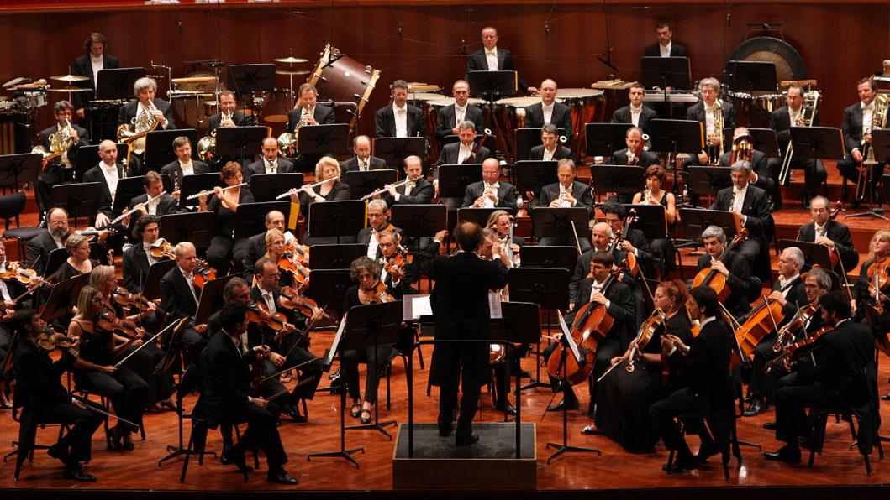
An ecosystem approach is needed to address our country’s biggest issues
Academia
Social enterprise
Local gov
State gov
Non-profits
Federal gov
Private sector
Better societal outcomes
Trust
Homelessness
Climate change
Refugee resettlement
COVID-19
Notes:
This has big implications for how we get things done in govt today. Instead of a solo performance, we need a symphony approach, with everyone playing from the same music, working together to achieve a great performance, in this case better social outcomes. How to do this is what our book is all about.

Slide 9
Bridgebuilders is a practical and actionable handbook that lists ten strategies that current government decisionmakers – as well as young leaders who aspire to public service – can learn from and apply right now to transform government and restore public trust.
1
9
10
Knock down barriers
Cultivate cross-boundary leaders
Make the exceptional routine
2
Seek mutual advantage
8
Redefine accountability
The 10 Core
Bridgebuilding Strategies:
3
Nurture private partners
7
Make data the language
4
Build trustworthy networks
5
Grow catalytic government
6
Focus on outcomes
Notes:
In the book, we lay out 10 core bridgebuilding strategies:
Today, we’ll preview 3 of them (to learn about them all, well you’ll just have to buy the book…).

Slide 10
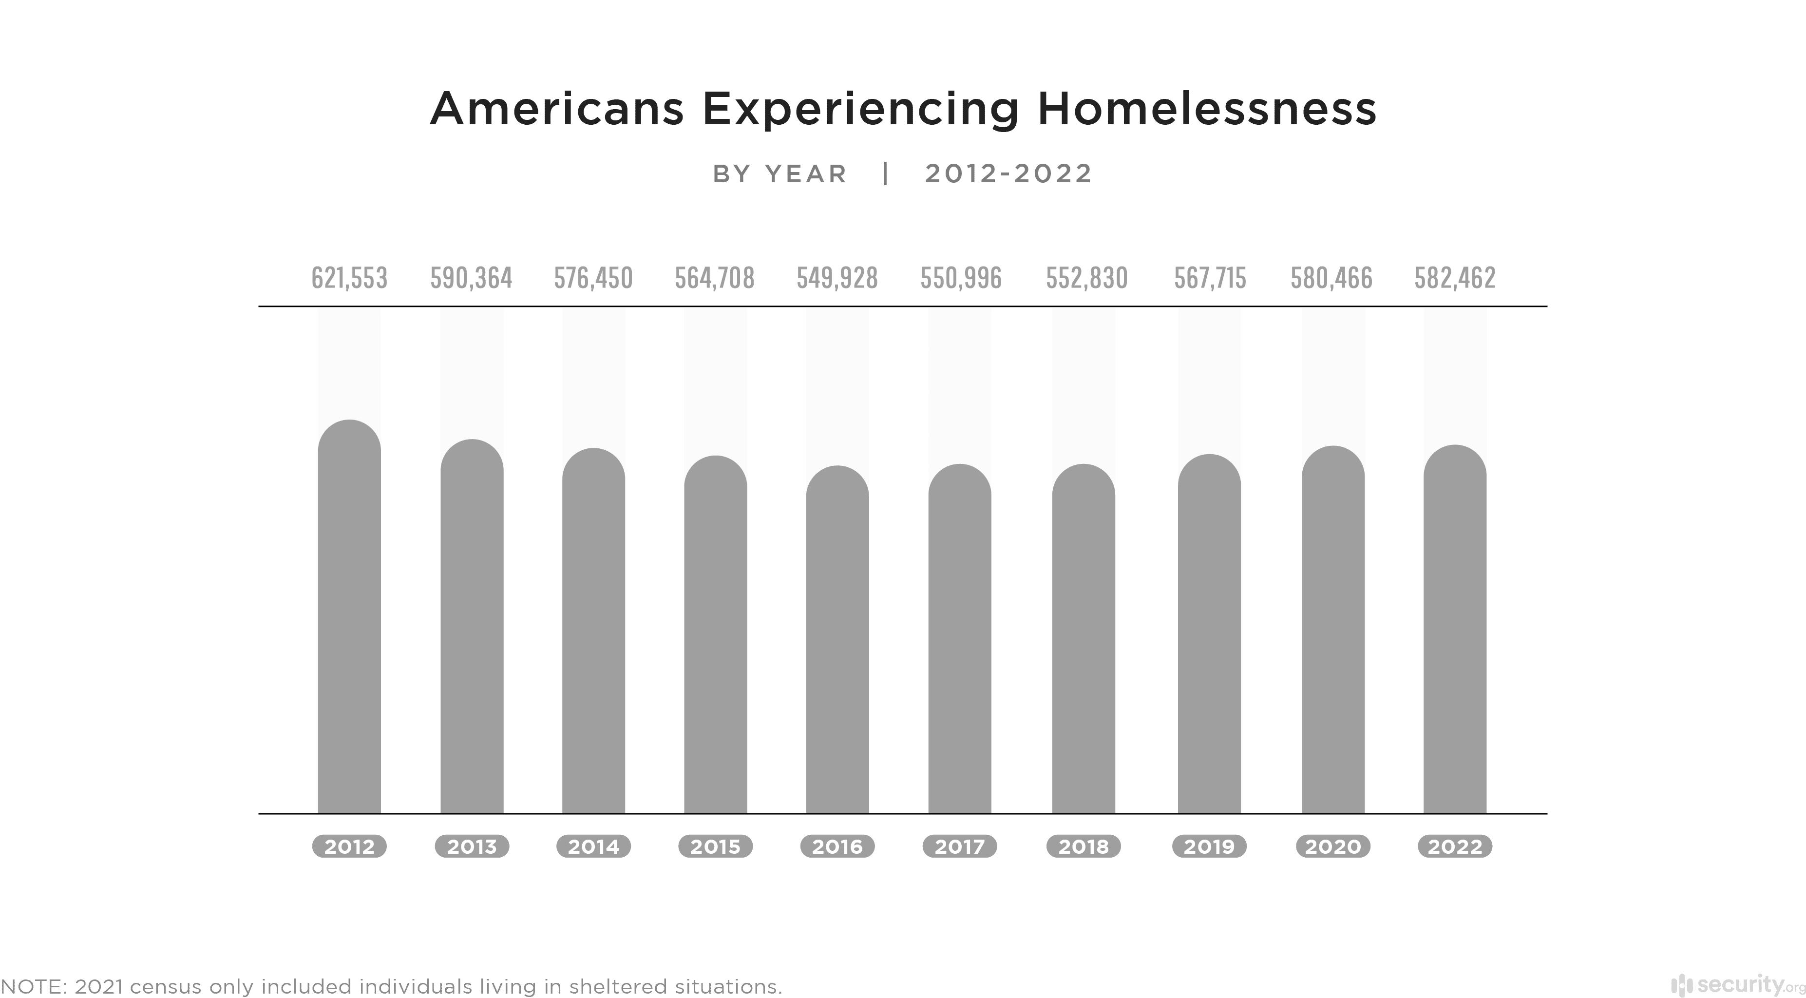
Cities across the country are struggling to make headway against homelessness
One city successfully did so…
Notes:
Nowhere is this more the case than in tackling one of the biggest crises in many cities today, the seemingly impossible challenge of reducing homelessness.

Slide 11
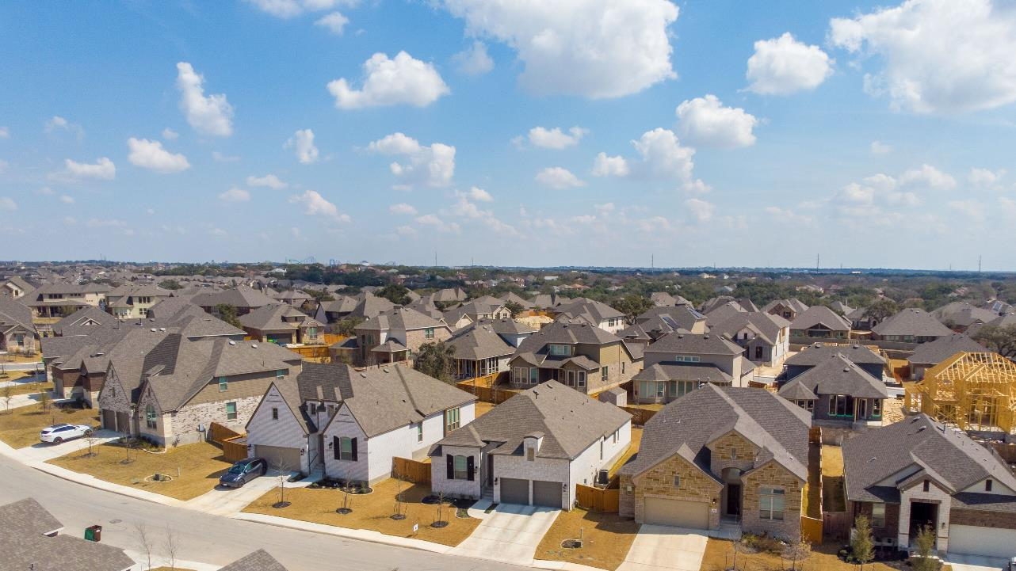
Since 2011, Houston’s homeless population has been reduced by 63%, with the city placing more than 25,000 of homeless residents in housing
Notes:
While cities nationwide have struggled mightily with this extraordinarily complex problem, one city has made massive headways.
Since 2011, Houston’s homeless population has been reduced by 63 percent, placing more than 25,000 of homeless residents in housing

Slide 12
Where we would stand if we had been able to achieve Houston’s results nationwide
366,951
63%
Notes:
If we had been able to achieve Houston’s results nationwide, we would have 200K less homeless people in the country today, equivalent to totally eliminating homelessness in the top 10 cities with the largest homeless populations. So, how did Houston do it? Bridgebuilding.

Slide 13
In 2011, Houston had one of the nation’s largest homeless populations
Notes:
Now they didn’t exactly start from a rosy position. In 2011, Houston had one of the nation’s largest homeless populations, exacerbated in part, from the tens of thousands of people who re-located to the city after Katrina.

Slide 14
The homelessness system was disjointed with duplicative services and service gaps.
Different organizations were all working in their own lanes, according to their own rules and procedures, doing what they wanted to do.
Annise Parker
Former mayor
of Houston
Notes:
Their system was disjointed, replete with duplicative services and service gaps.
“Different organizations were all working in their own lanes, according to their own rules and procedures, doing what they wanted to do,” said Annise Parker, the city’s former mayor, who launched their reforms.

Slide 15
This problem was hardly unique to Houston.
Government agencies and nonprofit service providers around the nation struggle to coordinate, communicate, analyze data, and relay information effectively
Greater Houston Area
9,444 square miles
New Jersey
7,354 square miles
~ 1.3X
New Jersey
Notes:
Houston’s sprawl made the problem especially challenging. Its metropolitan area is larger than New Jersey, with residents who speak more than 145 languages.
At the time, Houston’s service providers had no way of knowing what services an individual had already received, or where. They had no way to share case plans or track outcomes.
This problem was hardly unique to Houston. Government agencies and nonprofit service providers around the nation struggle to coordinate, communicate, analyze data, and relay information effectively

Slide 16
The key to Houston’s effort is the remarkable weaving together of more than 100 partners, across all the sectors with data as the connector
Homeless population
Ecosystem partners
DATA
Non-profits
Government
Notes:
Two key elements defined Houston’s success: 1) The remarkable weaving together of more than 100 partners, across all the sectors, with the Houston Coalition for the Homeless seeing itself as “the ‘conductor’ of the local homeless response system ‘orchestra.’
2) Critical to this weaving together was the coalition’s data system, which helps each provider understand each homeless person’s individual needs and concerns and share that information with others in the system. In Houston, data doesn’t just function as a deliverable but as the map that gives providers a fuller picture of the actual individuals behind the data.

Slide 17
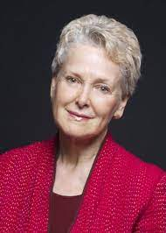
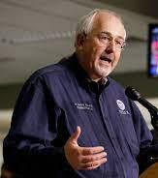
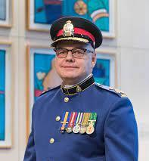
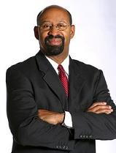
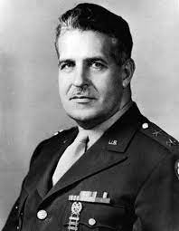
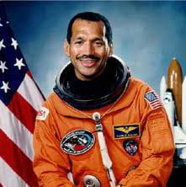
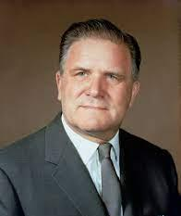
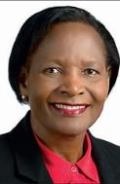
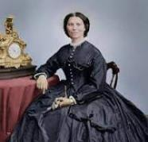
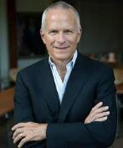
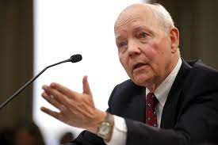
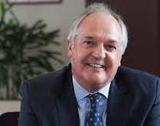
To deal with the world of blended government
Notes:
The problems governments face and the solutions governments need, inevitably, build on blended government. Governing this blended system requires bridgebuilders.
Not dozens more, not hundreds, not thousands, but millions of bridgebuilders. I hope one of them is you. Thank you so much for your time and your commitment to public service.

Slide 18
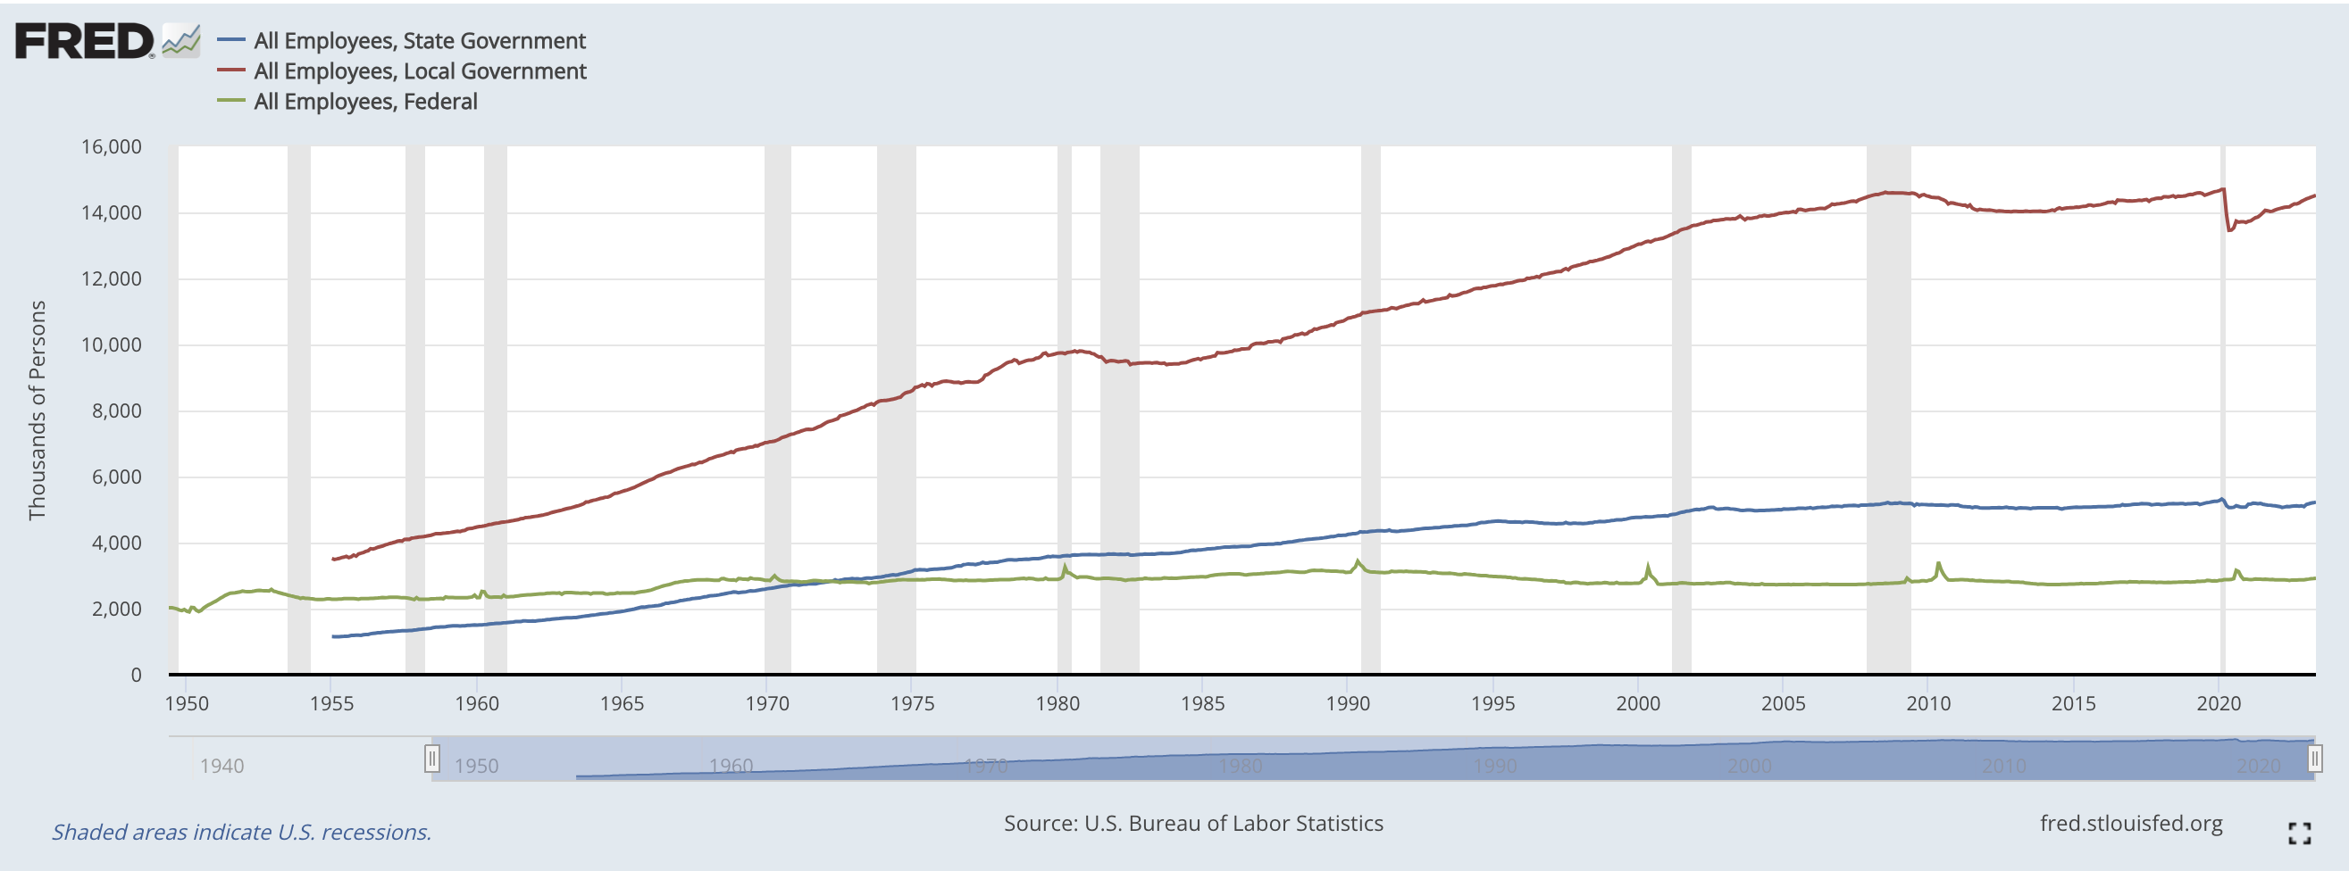
Vast opportunities for impact—at the state and local levels

